Slide 1
Panoramic Video in Environmental Monitoring Software Development and Applications
Presented by Jay W. Johnson
Advisor: Cheng-Chien Liu, Ph.D.
Laboratory of Remote Sensing and Earth Environment Monitoring
Earth Sciences Department, National Cheng Kung University

Slide 2
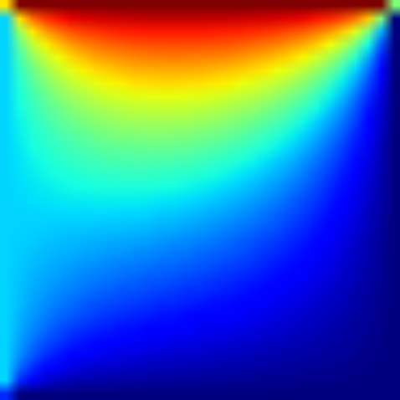
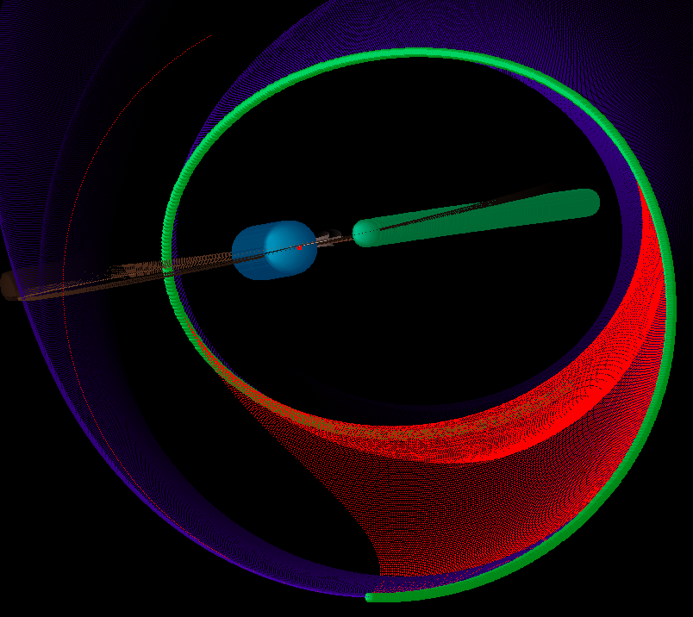
Python experience
Started learning Python last summer when I took a tutorial on scripting for ArcGIS
Programming
Computational Fluid Dynamics
2D Shallow water model, heat equation, orbiting masses, etc.
NumPy, MatPlotLib, Visual Python
Evolutionary Computation
Genetic algorithms, optimization methods
Image Processing
Like the following project…

Slide 3
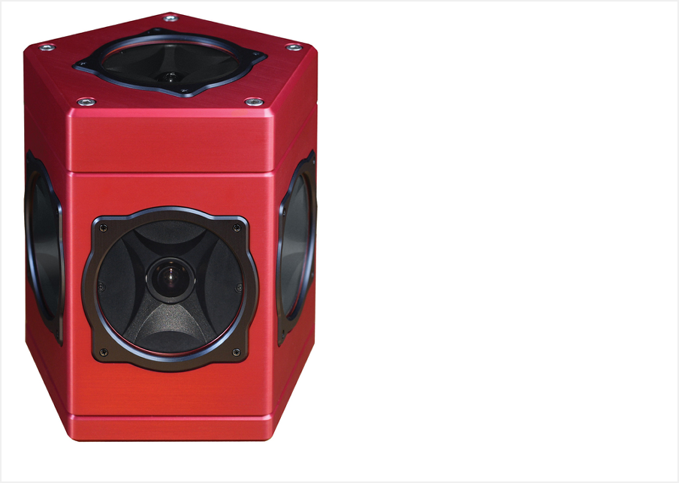

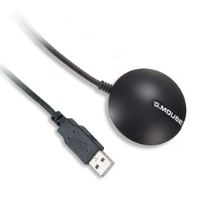
Ladybug3 360° Spherical Camera
Point Grey Research (PGR) based in Canada.
Advanced digital camera products.
Notes:
Records GPS data along with the video data into the same file.

Slide 4
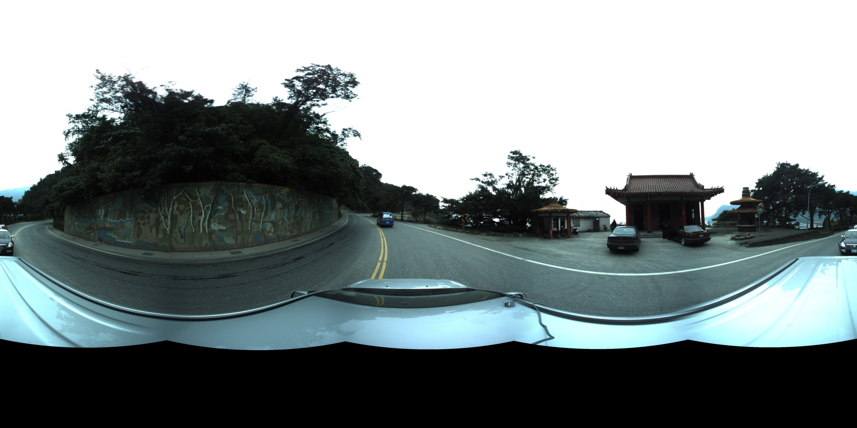
Example of panoramic output
Extract frames from the recorded video as a panoramic JPEGs.

Slide 5
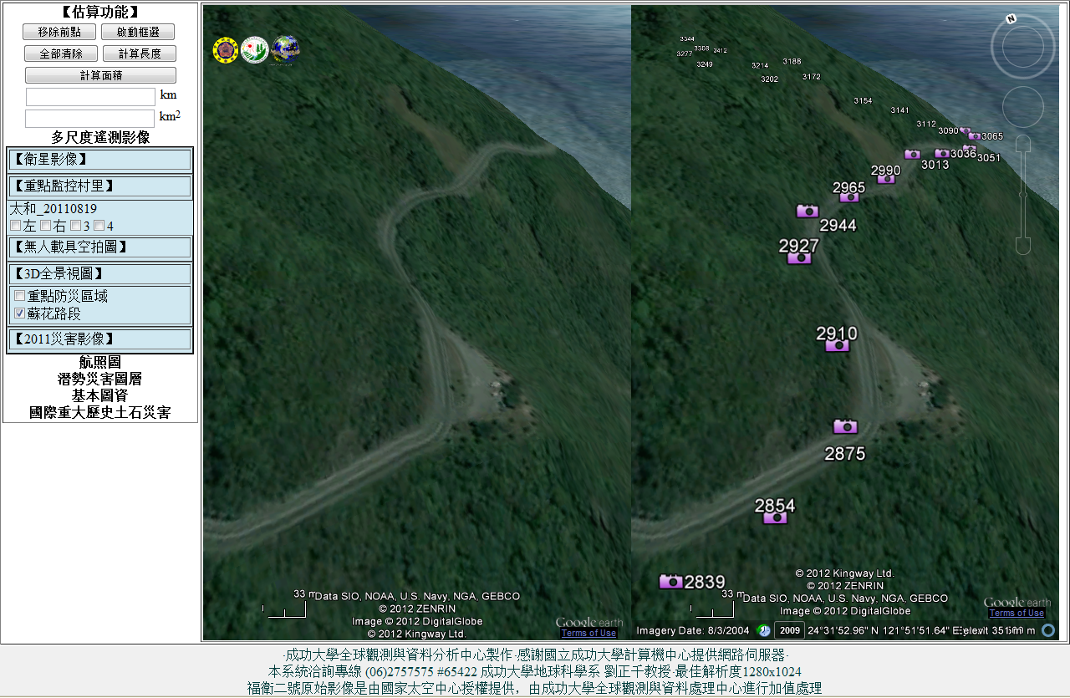
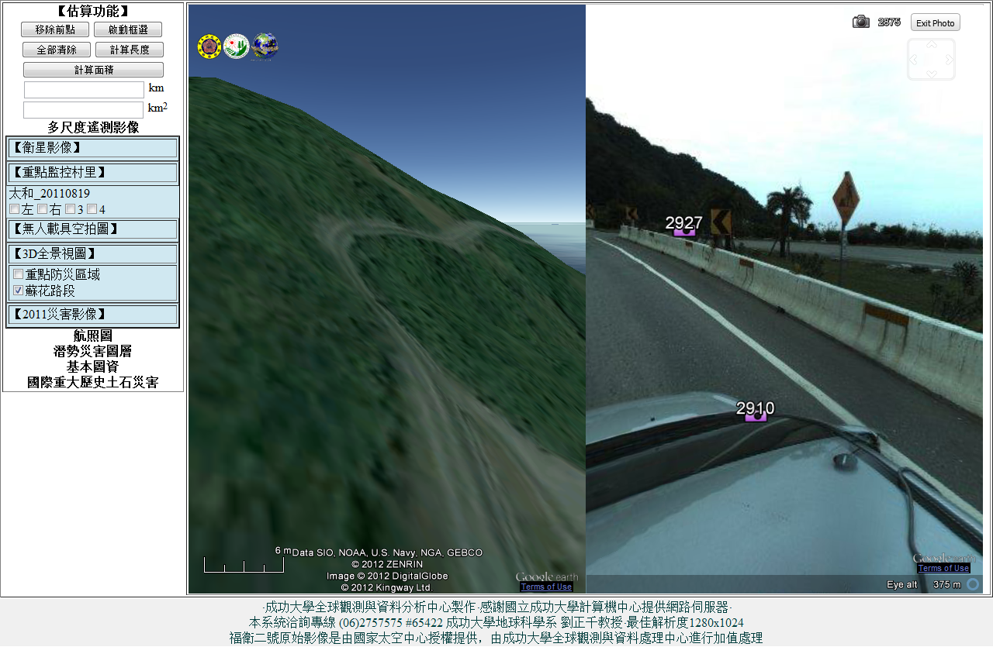

Global Earth Observation and Data Analysis Center - NCKU
Notes:
GEODAC . Rapidly respond to disasters with multi-temporal satellite imagery

Slide 6
Ladybug3 360° Spherical Camera
Environmental Monitoring Application?
Time-series comparison of one location
Track changes in environment conditions
Road and roadside deformation
Landslide enlargement or revegetation
Get information about the 3-dimensional space
Measure distances and sizes
Road and lane width
Landslide size
Notes:
Can directly post JPEG images with GPS data directly to a GIS system like Google Earth.

Slide 7
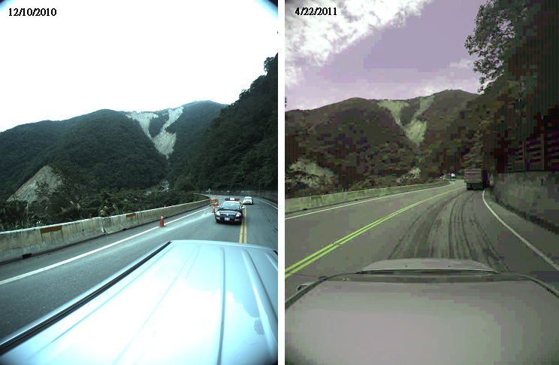
Landslide application
Software matches position and orientation within video streams.
Images can be exported to another application for image processing .
Notes:
Goal is to quickly locate the same view from all available videos.

Slide 8
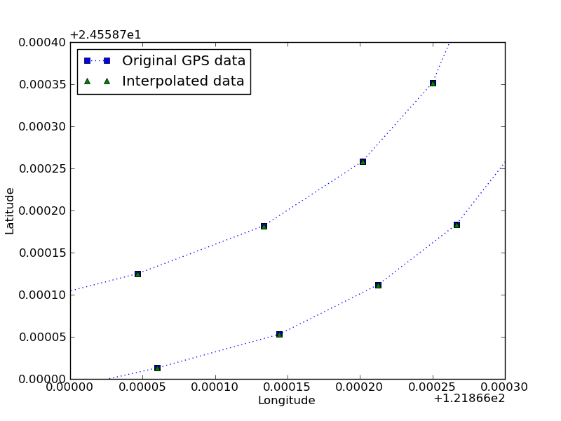
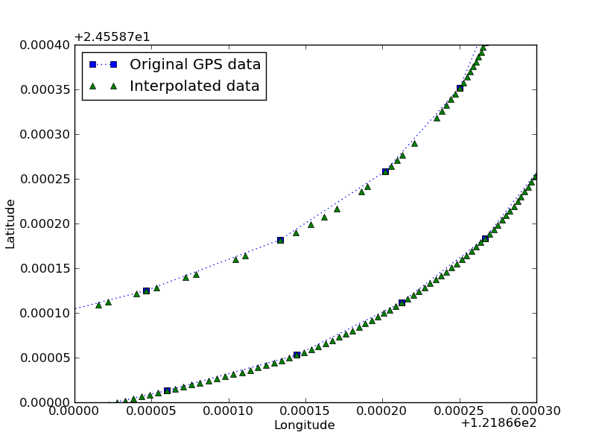
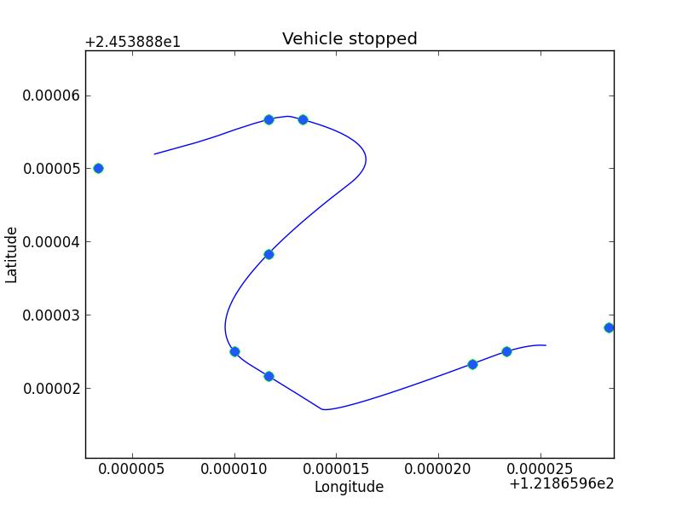
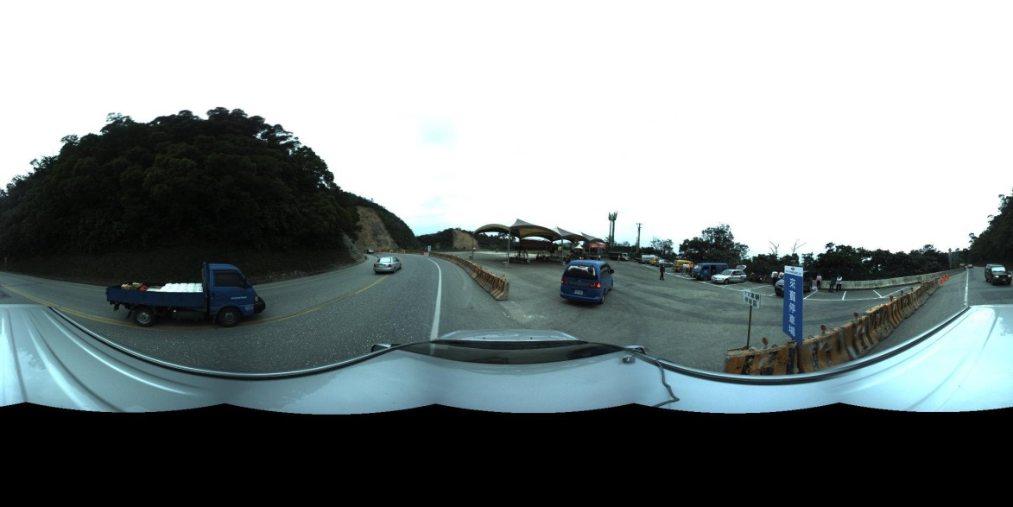
Accurate GPS data is needed
GPS data issues
Most devices sample once every second
Inaccurate up to several meters
Ladybug software issues
Does not orientate images when outputting panoramas
Calculate this and edit the images before publishing
Does not output a set of evenly spaced images
North(?)
Notes:
Google Earth default is to place center of panoramic image facing north.

Slide 9
How to get accurate GPS data
IMU (inertial measurement unit)
An additional instrument to connect to a laptop
Does not help with previously recorded video
Visual odometry (a.k.a ego-motion)
Calculating the change in a camera’s position and orientation from a series of related images
Topic in robot localization: such as robotic planet rovers

Slide 10


Setup and modules
Python (x,y) on Windows 7
Includes many useful modules.
NumPy, VPython, OpenCV, PIL, Tkinter, etc.
Note: make sure the modules you want are checked during install.
Spyder IDE
The only module I downloaded separately was pexif.
Add or edit EXIF data in JPEG images.
Ladybug API (camera control and video stream access)
SIFT (scale invariant feature transform) demo program
Notes:
Python (x,y) includes all the important modules you need to do scientific computing as well as good IDE and other programs.

Slide 11
Ladybug API + ctypes = API Wrapper
PGR provides the C/C++ API library (ladybug.dll)
Adapted only the methods related to accessing video files
Ctypes: Loading a DLL
libc = ctypes.CDLL('ladybug') # loads the ladybug.dll
Accessing methods
libc.ladybugGetCameraUnitImageCenter(context, cameraNum, centerX, centerY )
C++ memory management
ctypes.create_string_buffer( bytesize )
centerX = ctypes.create_string_buffer(8)
(run method)
centerX = struct.unpack('d', centerX )[0]
Pythonified API method
ladybug.GetCameraUnitImageCenter(cameraNum ) => centerX, centerY
Ladybug API Library (C/C++)
Ladybug API Interface Class
(Python)
Ladybug3 Application
(Python)
Ladybug API Wrapper (Python:ctypes)
Notes:
Because it is C++, you need to calculate ahead of time how big of a buffer to set aside and pass to the method for writing.

Slide 12
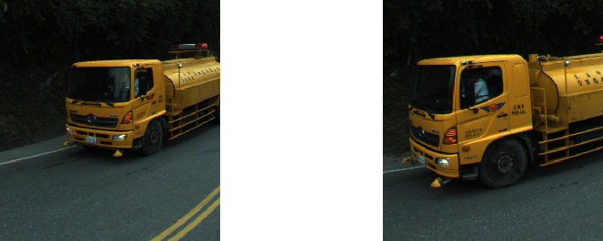
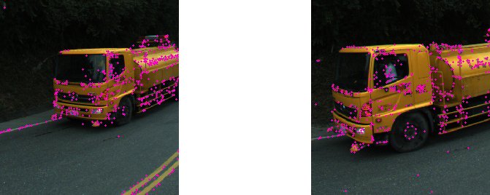
SIFT – Scale-Invariant Feature Transform
Algorithm developed and published by David Lowe in 1999
SIFT finds thousands of unique points within a single-band PGM image.
subprocess.call( sift_fname+'<'+PGMfilename+'>'+outfname+'.key', shell=True)
Each point is given a numerical description of 128 values.
These numeric descriptions are similar despite rotation, scaling, affine distortion and lighting.
Matches are found by finding the pair of points that minimize the Euclidean distance between the 128 descriptors.
333.96 819.11 30.39 0.894
25 104 41 12 1 1 0 1 45 107 89 35 2 0 0 0 123 123 4 0
0 0 0 0 8 5 0 0 0 0 0 0 30 52 14 5 4 1 0 2
88 49 11 14 17 4 4 16 123 96 0 0 0 0 1 16 31 11 8 8
0 0 0 0 31 66 11 0 0 0 0 2 123 41 3 0 1 0 24 123
123 14 10 15 0 0 13 123 21 5 53 122 0 0 0 2 26 25 0 0
0 0 0 0 123 114 6 0 0 0 0 13 48 47 75 86 0 0 0 19
0 2 50 123 1 0 0 0
333.96 819.11 30.39 0.894
25 104 41 12 1 1 0 1 45 107 89 35 2 0 0 0 123 123 4 0
0 0 0 0 8 5 0 0 0 0 0 0 30 52 14 5 4 1 0 2
88 49 11 14 17 4 4 16 123 96 0 0 0 0 1 16 31 11 8 8
0 0 0 0 31 66 11 0 0 0 0 2 123 41 3 0 1 0 24 123
123 14 10 15 0 0 13 123 21 5 53 122 0 0 0 2 26 25 0 0
0 0 0 0 123 114 6 0 0 0 0 13 48 47 75 86 0 0 0 19
0 2 50 123 1 0 0 0
203.11 894.09 102.38 1.601
82 54 0 4 6 0 0 0 161 161 0 0 0 0 0 1 89 37 0 0
0 3 3 0 0 0 0 0 0 0 0 0 118 11 0 5 6 0 0 22
161 86 24 0 0 0 0 89 128 53 97 5 0 0 0 8 0 0 3 0
0 0 0 0 82 40 0 1 4 0 0 6 124 161 161 3 0 0 0 18
9 32 161 30 0 0 0 1 0 0 7 0 0 0 0 0 4 4 0 0
0 0 0 0 3 12 16 0 0 0 0 0 0 0 23 3 0 0 0 0
0 0 0 0 0 0 0 0
506.14 375.76 103.55 1.994
0 0 12 119 19 0 0 1 47 4 7 40 12 0 0 12 102 3 0 0
0 0 0 31 4 0 0 0 1 0 0 0 0 0 17 104 5 0 0 0
148 40 10 25 3 0 0 11 154 100 0 0 1 0 0 30 34 8 0 3
42 20 0 2 2 0 2 36 5 0 0 2 142 6 1 5 1 0 0 83
154 20 0 0 0 0 0 118 48 2 0 0 6 19 1 10 20 0 0 12
2 0 0 13 128 22 1 0 0 0 0 154 154 35 14 0 0 0 0 142
18 4 2 0 0 0 0 5

Slide 13
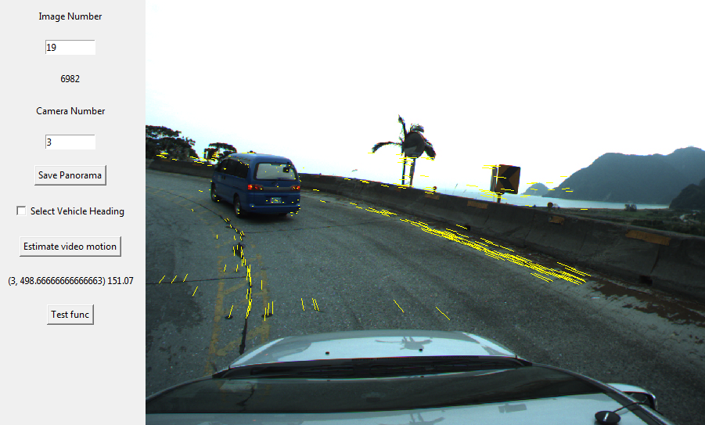
SIFT flow vectors

Slide 14
OpenCV
Importing OpenCV
import cv
import cv2
import cv2.cv as cv #for trying older examples
Pythonified interface
cv2 removes the need for creating empty buffers before calling a method and the need to copy arrays into a cv type matrix.
cv example of calculating a homography
s = cv.CreateMat(len(bottom_matches), 2, cv.CV_32F)
d = cv.CreateMat(len(bottom_matches), 2, cv.CV_32F)
for match in range(len(bottom_matches)):
s[match,0] = x1bot[match]
s[match,1] = y1bot[match]
d[match,0] = x2bot[match]
d[match,1] = y2bot[match]
H = cv.CreateMat(3, 3, cv.CV_32F) # BUFFER FOR RETURN VALUE
cv.FindHomography(s, d, H, cv.CV_RANSAC)
cv2 version: Directly use numpy arrays
source = matches[bottom_matches][:,0:2].copy()
destin = matches[bottom_matches][:,2:4].copy()
H, mask = cv2.findHomography(source, destin, cv2.RANSAC)
views are not allowed, need to copy

Slide 15
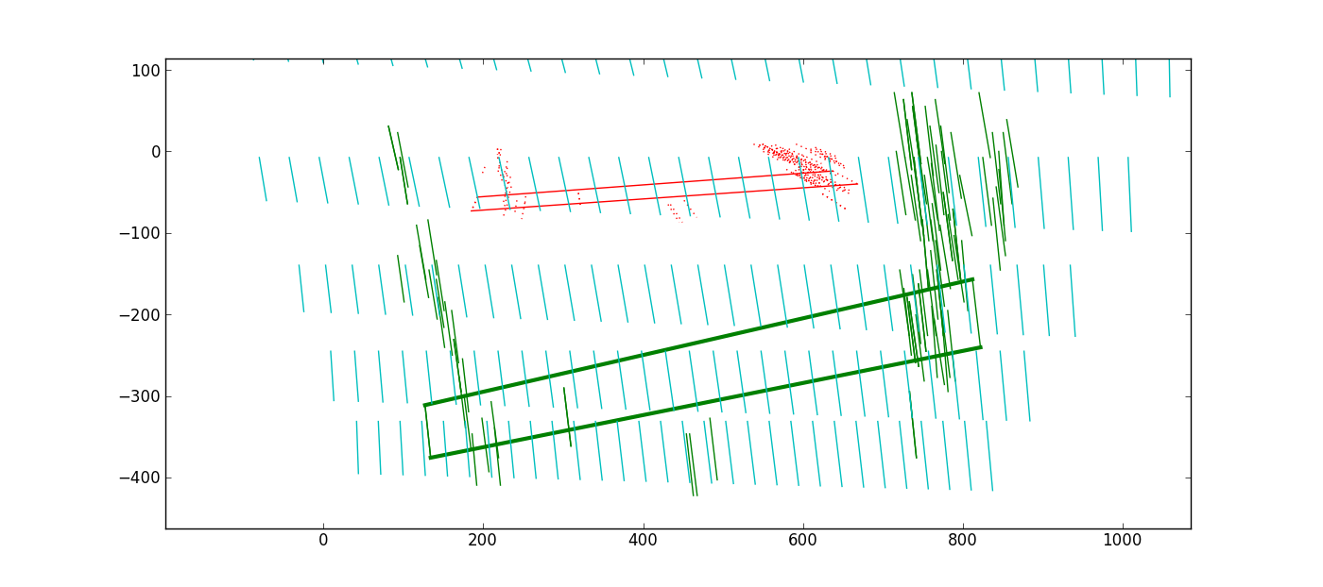
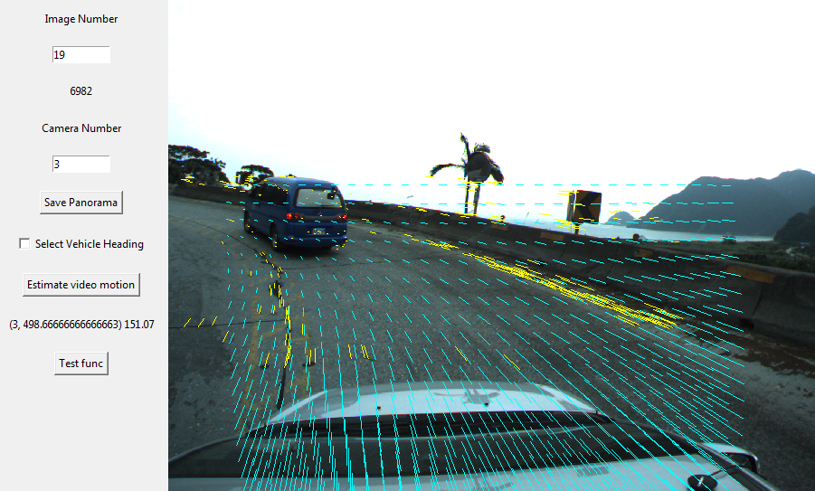
Homography derived flow field
Notes:
FindHomography method finds the best translation of a plane from one image to the next.

Slide 16
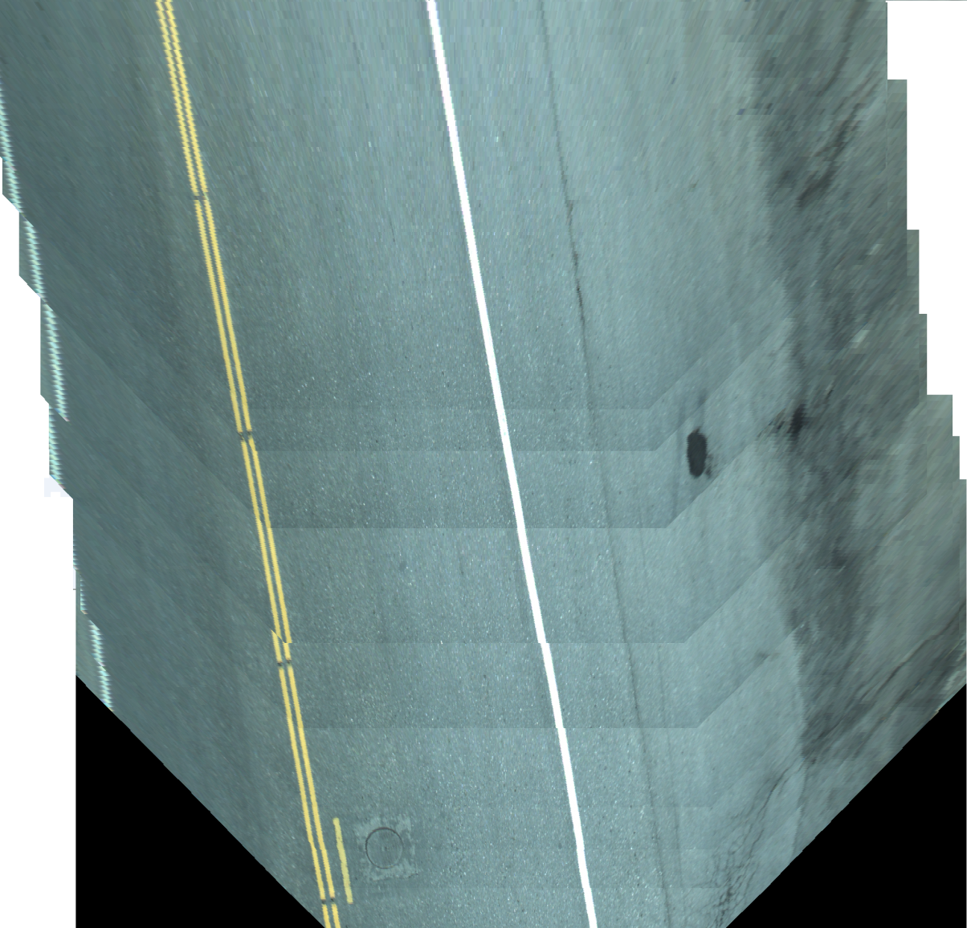
Perspective transform
PIL –
src_image.transform( dst_size, Image.PERSPECTIVE, transformation_data )
OpenCV –
cv2.warpPerspective( src_image, transformation_matrix, dst_size )
A series of transformed
images from one camera

Slide 17
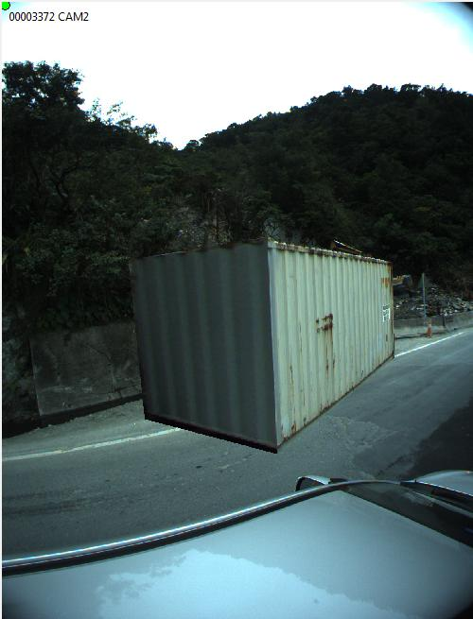
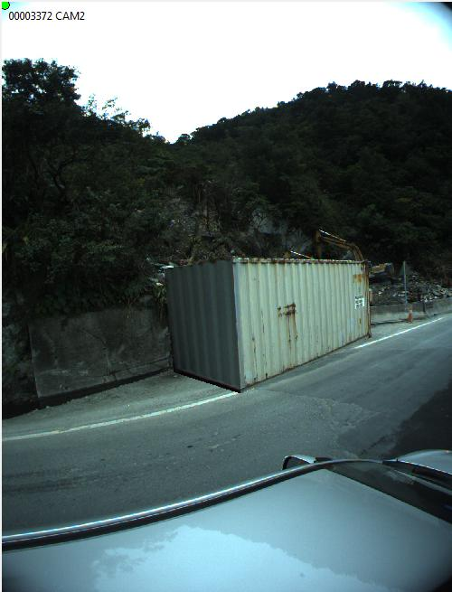


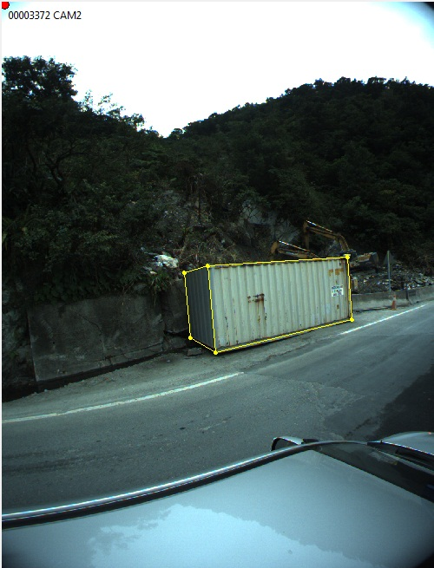
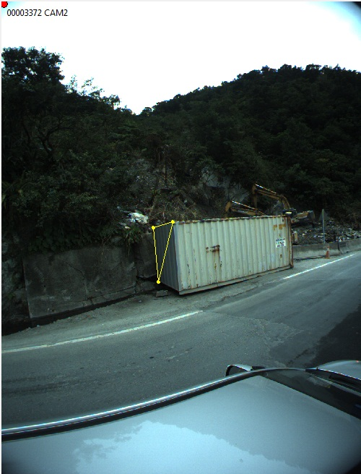



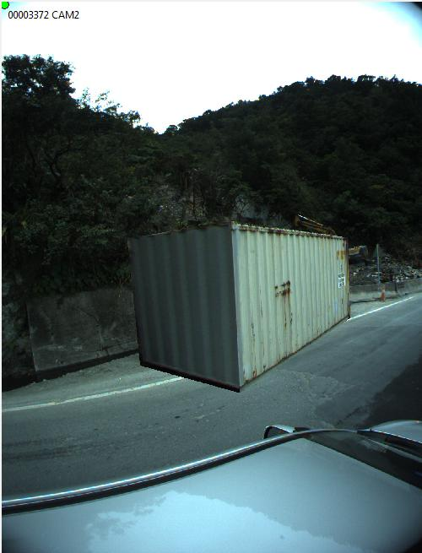


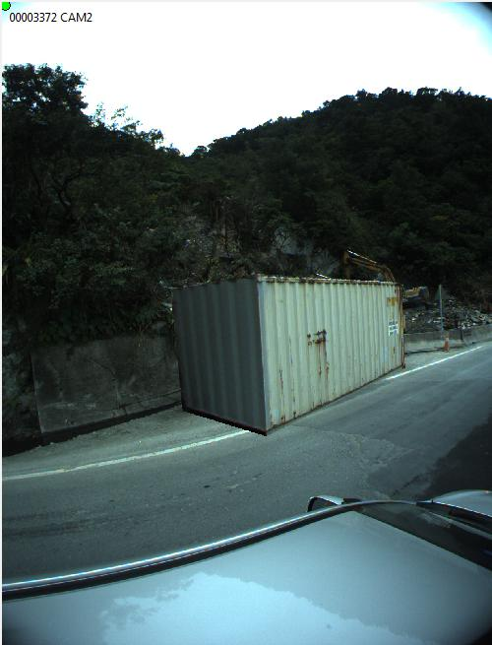
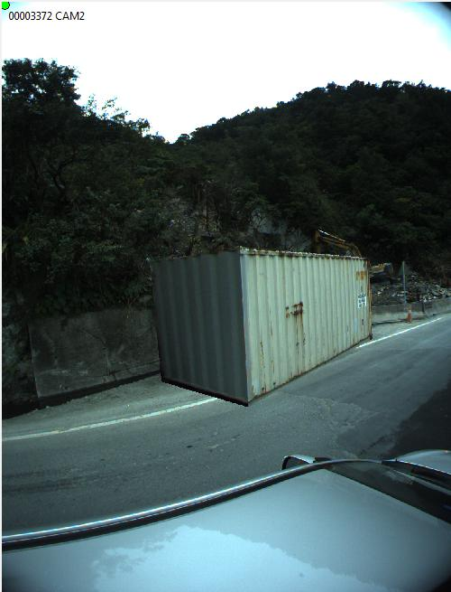
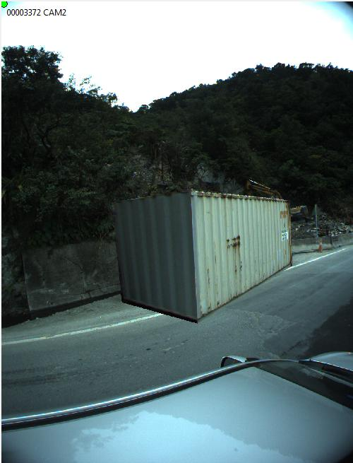
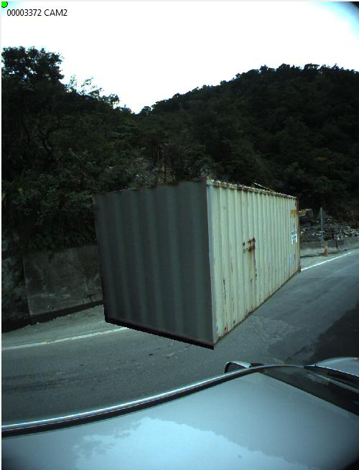
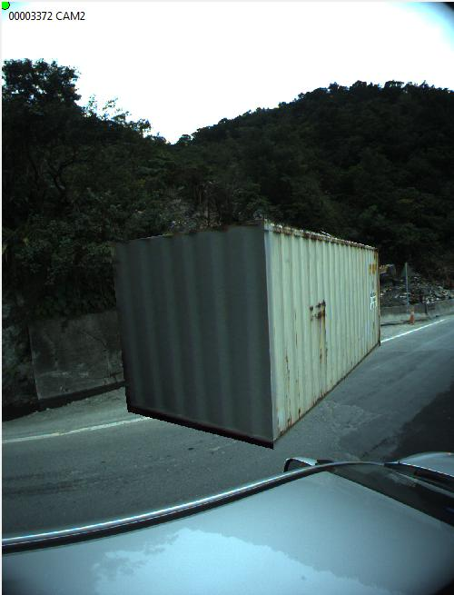


3D object selection and manipulation
Create 3D objects from scene
Add structures or objects

Slide 18
Adding GPS data to JPEGs with pexif
Open a JPEG file
jpeg = pexif.JpegFile.fromFile( filename )
Use set_geo method
jpeg.set_geo(GPSLatitude, GPSLongitude )
Adding altitude data
jpeg.exif.primary.GPS.GPSAltitude = [pexif.Rational(GPSAltitude * 10, 10)]
Overwrite file or save to new location
jpeg.writeFile( filename )
Notes:
The set_geo method only adds lat and lon. Must use a less straightforward way to altitude.

Slide 19
Closing remarks
A lot of error is accumulated during the process
Image resolution and resulting matched points
Instability in the camera view
Differentiating road flow vectors from that of other objects
Still a work in progress
The goal here is to have a simple method to correct panoramic image orientation and location through image analysis for a quick look up of related views in multiple videos.
Then expand the functions with depth map generation and measuring objects within a panoramic image.

Slide 20
References
End of line…
Jay W. Johnson
python@boun.cr
Lowe, D.: Distinctive image features from scale-invariant keypoints. International Journal of Computer Vision, 60(2):91–110, 2004.
Hu, R., Shi, R., Shen, I.F., Chen, W.: Video stabilization using scale-invariant features. In: IV 2007 11th International Conference on Information Visualization, pp. 871-877 (2007)
Hartley, R., Zisserman, A.: Multiple View Geometry in Computer Vision. , Cambridge University Press, New York, NY, 2000

Slide 21


